Slide 1
Task handling

Slide 2
Gliederung
Used integrated development environement(IDE)
Starting Postgres and loading the table „articles“
Load of the Data
Implemented Models
Comparaison of models

Slide 3
Used IDE
In the place of Jupyter, Spyder was used to process the task. Sypder seems to be better suited for processing large amounts of data.
The loaded library via anaconda can be found in the environment variable. It is located in the working folder with the name myEnvTest.yml and can be just imported into Anaconda.

Slide 4
Load of the data
Docker was used to execute the two database scripts and load the table articles. Alternatively, if postgres is available locally, it is also sufficient to clone the given working folder and execute only the database scripts in with the Git-bash terminal, then get connected to the database via Spyder and load the table “articles”.
At the same time the remaining data is loaded from Dropbox,

Slide 5
Implemented Models 1
LSTM-Model-2to1:
For the realization of this model, only two features were treated: "cancelation" and "prices". The reason was that "cancelation" correlates more with "prices" than the other features. See the following figure (next Page).
***The weather was not taken into account

Slide 6
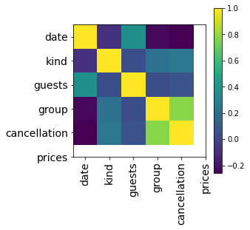
Implemented Models 2
Feature correlation heatmap

Slide 7
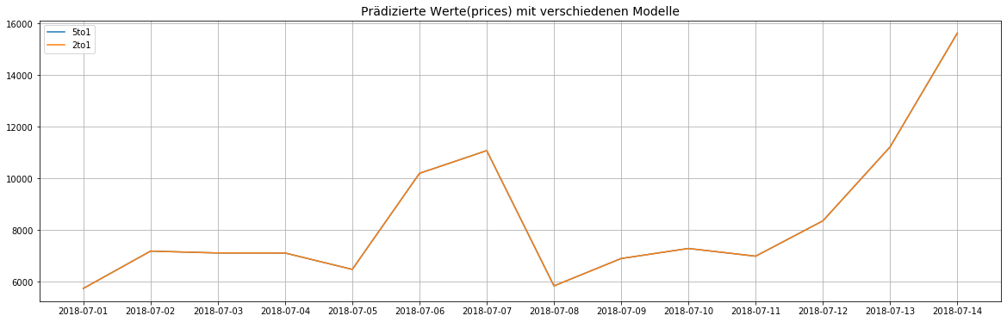
Implemented Models 2
LSTM-Model-5to1
To be on the safe side, all remaining features were considered in this case. It could be determined that the predicted values were close to identical. See the following figure (done with the script plot_litt).

Slide 8
Implemented Models 3
fbProphet-Model 1
Only one feature was used here, that of price. The model here gives a lot of information. However, in our case the three most important pieces of information were selected: The actual predicted price, the minimum and maximum price. See the following figure on the next page.
***However, the script from the Prophet model may not start . It is due to the library. It worked on my PC (mac OS, "pip install fbProphet"), but did not work with Windows (I tried everything, also https://anaconda.org/conda-forge/fbprophet).***

Slide 9
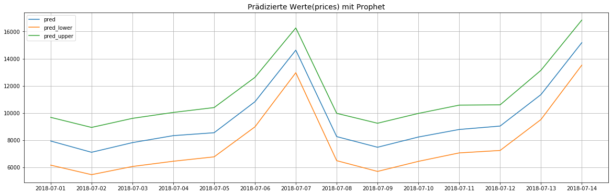
Implemented Models 4
fbProphet-Model 2

Slide 10
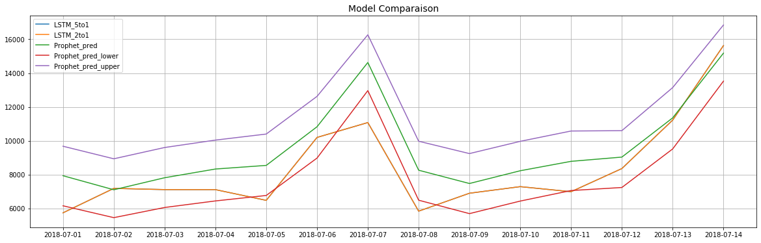
Comparaison of models
It is important to ensure that the predicted values from the two LSTMs are almost identical.
We can also see that they all follow the same trend

